Slide 1
Gabriel Galeote Checa
Project Bioimplantable Device for Optogenetics Techniques | What I did last four weeks? Test circuit Order and test substrates Design antenna
Problem being faced? Soldering techniques (Flip-chip and wire bonding) Antenna design and tunning | What to do in next two weeks? Finish circuit prototype Test different substrates Test different antennas

Slide 2
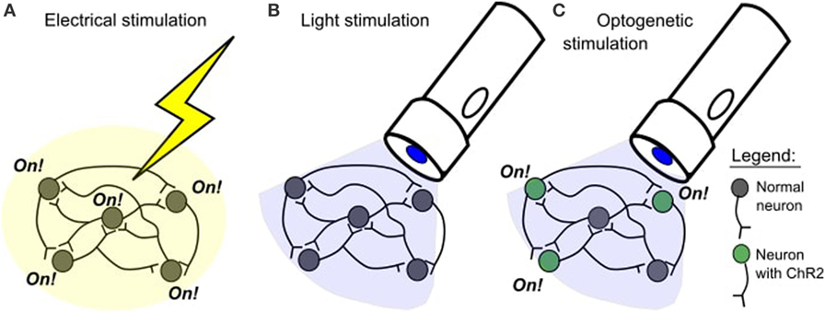
Bioimplantable Device
Purpose of the project
Wireless Power Supply
Microelectronic Device
Optogenetics Technique

Slide 3
Bioimplantable Device
Problems found
Soldering Techniques
LED requires wire bonding
LDO is a Flip Chip
INCREASES MANUFCTURING TIME!!
Configuration of antenna
Depends on many factors
Effective propagation area?
Antenna gain?
How to reduce the size?
Soldering with voltera
Effective propagation area?
Antenna gain?
How to reduce the size?

Slide 4
Bioimplantable Device
2. Further Work
Soldering techniques: Wire-bonding and flip chip → Increases the manufacturing time so far
Problems found
Propagation Distance?
Configuration of the antenna
Antenna Gain?
How to reduce size?
Voltera machine: many problems with ink, cleaning of needles, weakness of needles…

Slide 5
Bioimplantable Device
1. Previous Works
Technical Features
Substrate: Pyralux AP8535R, a flexible substrate for bioimplantable devices.
Microcontroler (µC ): ATtiny84(Atmel) → many documentation available.
LDO: NCP161 ON semiconductor → Good specs. for low power device.
Cree® TR2227™ LEDs→ 3.15 V and 20mA.
Other passive components: 0201 and 0402 package size.
Possible Problems
Accesibility to the µC: just once before the surgery.
Temperature of the implant due to the µC performance.
Biocompatibility problema when adding a µC in an implant (soldering components, resins, etc)

